Slide 1

Using Python in RStudio
Khady Diagne, MSc.
Bub Lab, PhD. Candidate in QLS
McGill University
Montreal, QC
Notes:
Introduce myself;
Ask attendees for a brief intro as well, what kind of work they do, proficiency in R/Python
Thank Monica & RLadies for inviting me to give this tutorial – Great initiative!

Slide 2
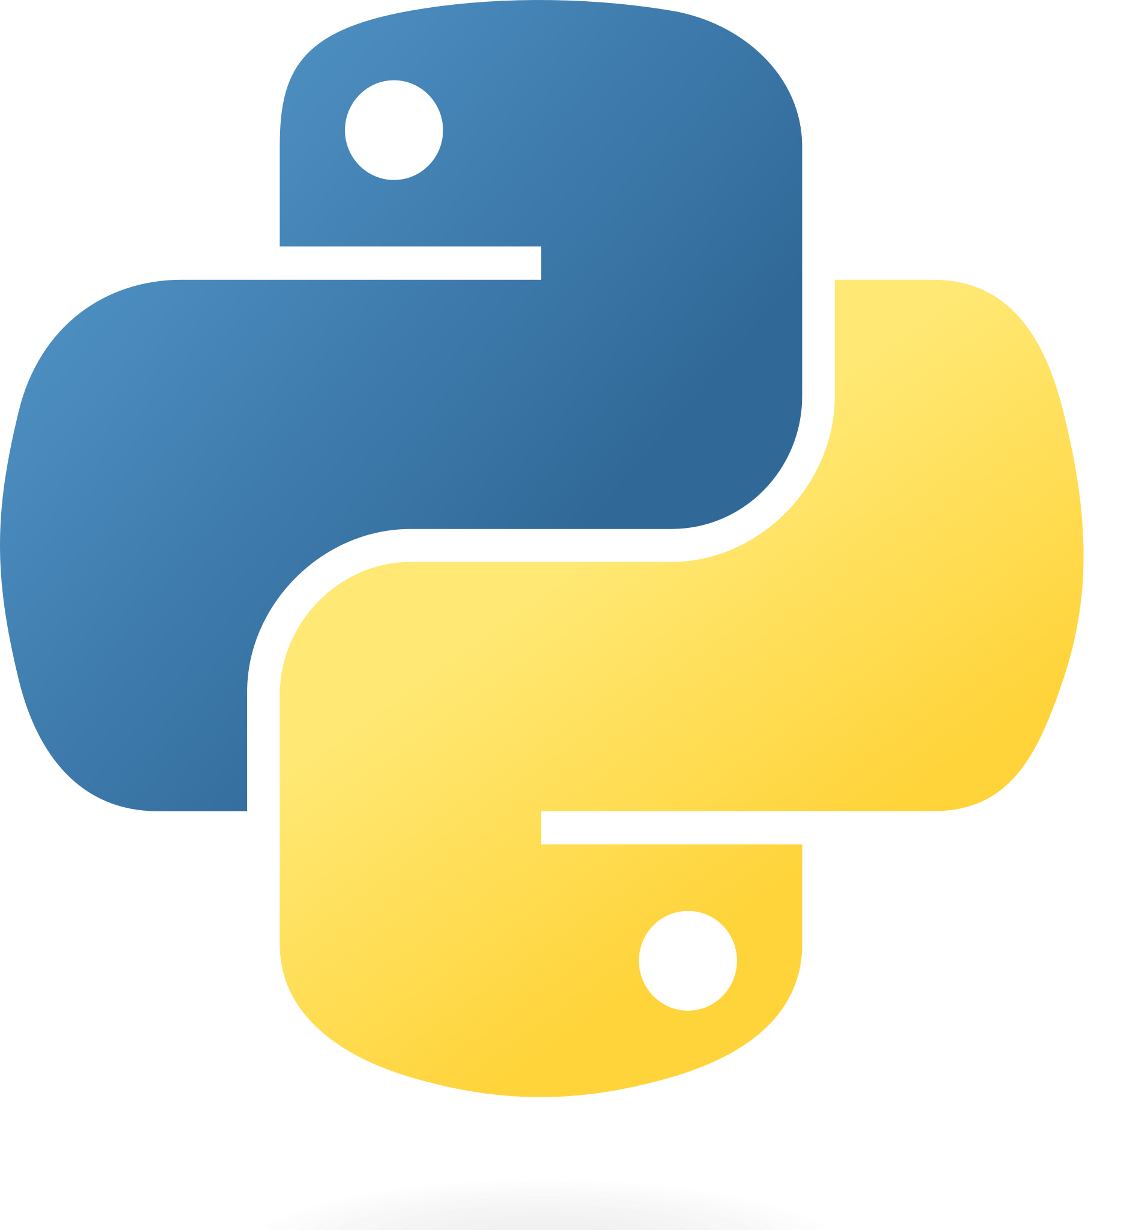


Layout
$$∈$$
What is Python?
Some history & Basis
Why Python?
Compare to R
Pros and Cons
How to run Python?
IDLE, PyCharm, VSCode, Spyder, JupyterLab/Notebook
And many, many more! Depends on what you’d like to use it for…
Running .py in Rstudio
Install Python + venv + packages
NB: not the *best* IDE to run Python, but very adequate for simple usage. IMO, Spyder is the best for python (for ML/Data Sciences)
Language
Syntax: Assignment/Comments/Print
Data types
Data Operations (math, logic & string)
Data Structures
Lists, sets, tuple, dictionaries.
Control structures
If/else if/ else
For/While loops
List Comprehension
Functions
Built-in (-> navigate documentation…)
DIY
Packages
Numpy, Scipy
Pandas (data frames!)
Matplotlib, Seaborn, Plotly
Scikit
Guided mini-project
Use Python packages/functions in an R script
Short Spyder Demo

Slide 3
What is python?
$$∈$$
A programming Language (such as R, C/C+, Java…)
Simple
Intuitive
Efficient
Created over 30 years ago
Large community
Huge growth since the 2010s
High-level
Translated into bytecode
Object-oriented
Notes:
bytecode (low-level set of instructions that can be executed by an interpreter).

Slide 4
Why python?
$$∈$$
Why not?!
Very versatile (Stats, modeling, machine learning, websites/software…)
Large community (social media, blogposts)
Soo many online resources
FREE!!
VS R?
R’s great for stats and data visualization.
Python’s great for data science, AI and web development
(Python’s syntax is closer to human language)
Cons:
Low Speed (Compared to compiled languages)
Inefficient memory consumption
Not ideal for mobile development
Notes:
bytecode (low-level set of instructions that can be executed by an interpreter).

Slide 5
How to use python?
$$∈$$
Python is a language; you need an Integrated Development Environment (IDE) to use it.
Some popular IDEs:
IDLE (OG Python IDE)
PyCharm
Favored by Web developers
VSCode
Popular amongst coders that use multiple languages
Spyder
My personal favorite, great for Data Science/Machine Learning
JupyterLab/Notebook
Comprehensive coding (classes, tutorials, collaboration)
And many many more, each with their own usages and strengths
https://wiki.python.org/moin/IntegratedDevelopmentEnvironments
Notes:
Rstudio is probably not the first one people would pick, but given that this is Rladies, we will start with that!

Slide 6

Running Python in R
$$∈$$
Rstudio is already equipped to read .py files.
The R package reticulate allows for interoperability between R and Python
https://rstudio.github.io/reticulate/
Download the Python version of your choice
Create a virtual environment for your libraries
Download packages to your environment
Open your .py file and start coding!
Notes:
Calling Python from R: https://cran.r-project.org/web/packages/reticulate/vignettes/calling_python.html

Slide 7
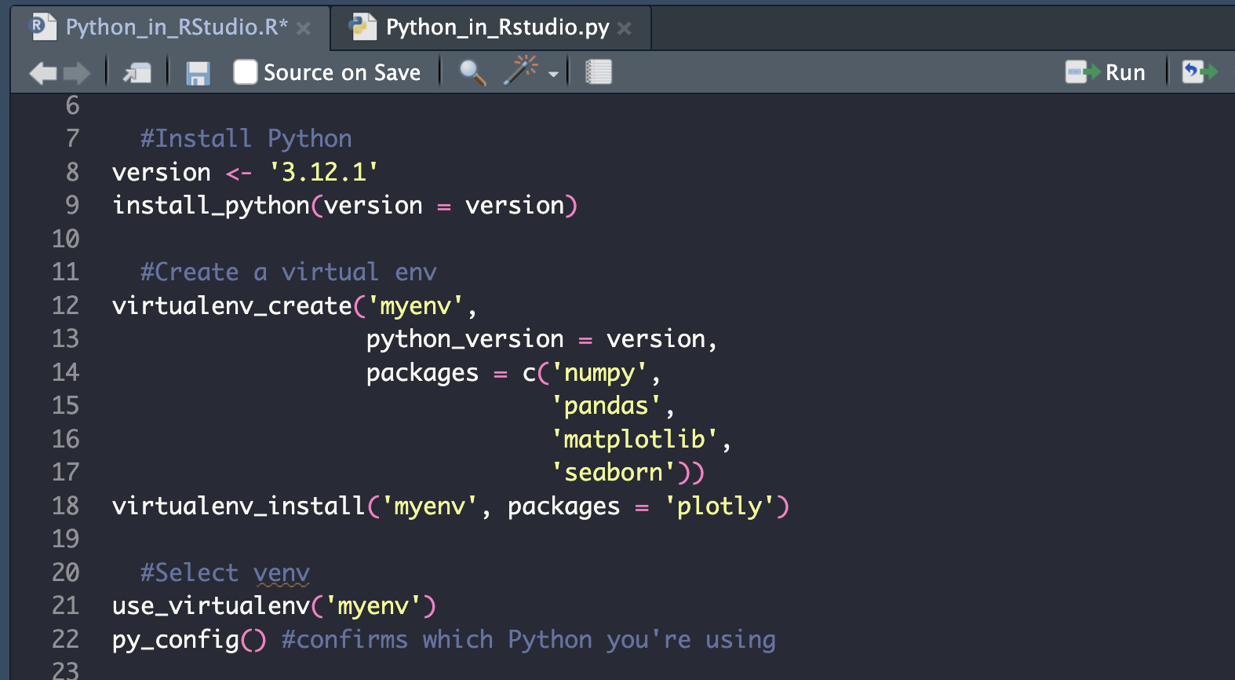
Let’s get started!
You should now be able to run a .py file

Slide 8
The language
Syntax: Assignment/Comments/Print
Data types
Integer, Float, Complex, String, Boolean
Data Operations (math, logic & string)
Data Structures
Lists, sets, tuple, dictionaries.
Control structures
If/else if/ else
For/While loops
List Comprehension
Notes:
https://www.tutorialspoint.com/python/python_basic_syntax.htm

